Slide 1
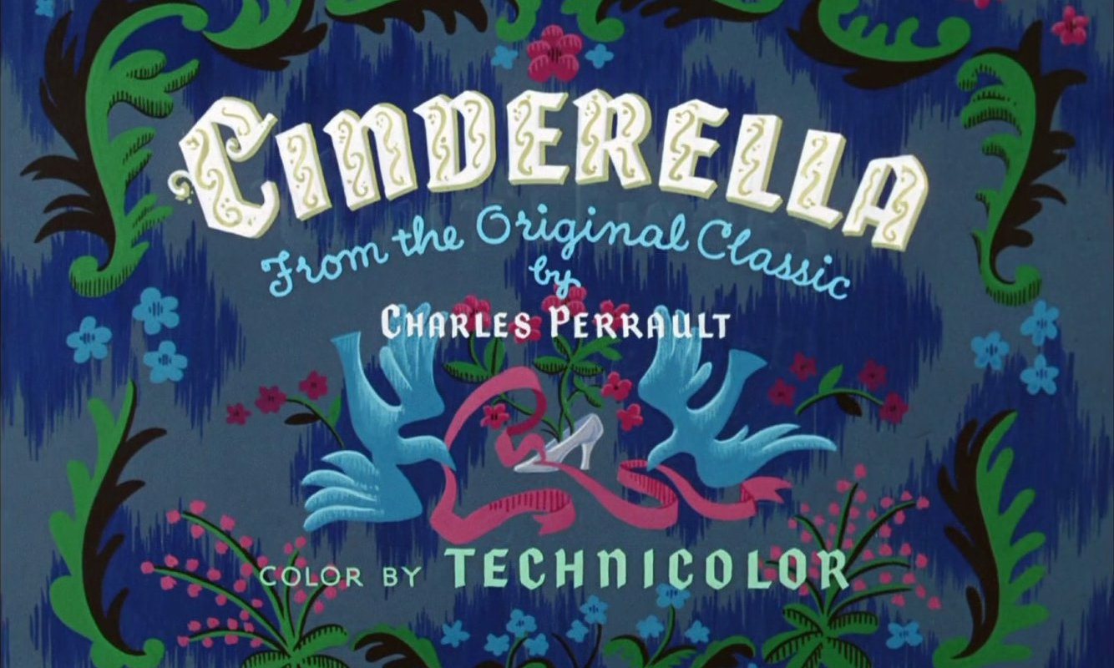
Disney’s Cinderella
Ideology, Gender, and Visual Rhetoric

Slide 2
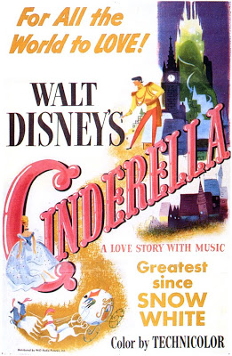
Background on Production
Released in 1950
Saved the studio financially
Most Popular full-length Disney film since 1937’s Snow White and the Seven Dwarfs

Slide 3
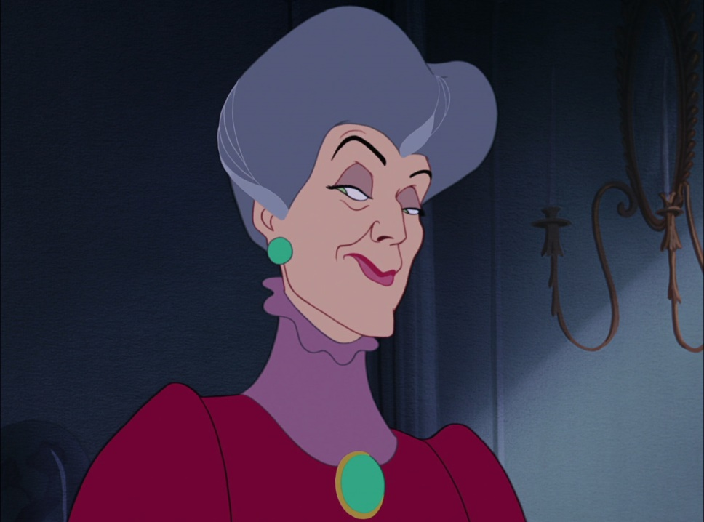
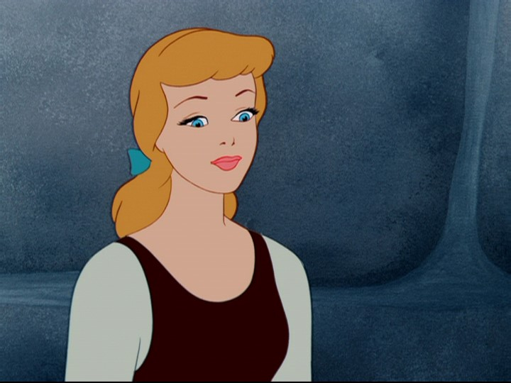
Antagonist /Protagonist
Lady Tremaine
Cinderella

Slide 4
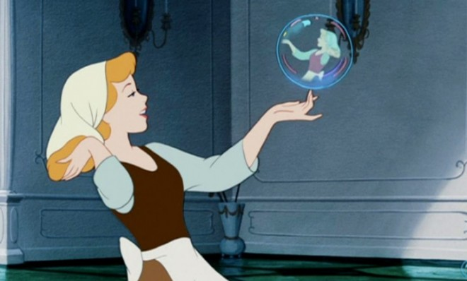
Mirror, Mirror

Slide 5
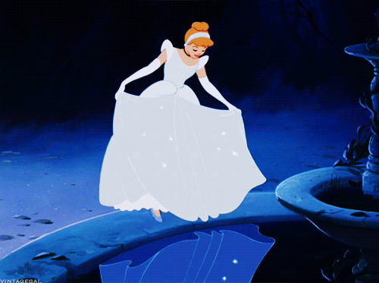
Another Mirror…

Slide 6
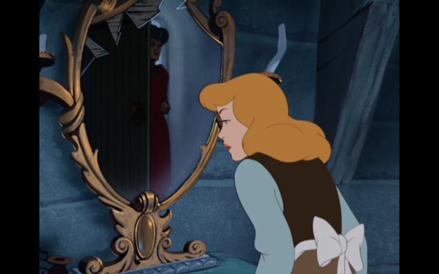
Dramatic Irony

Slide 7
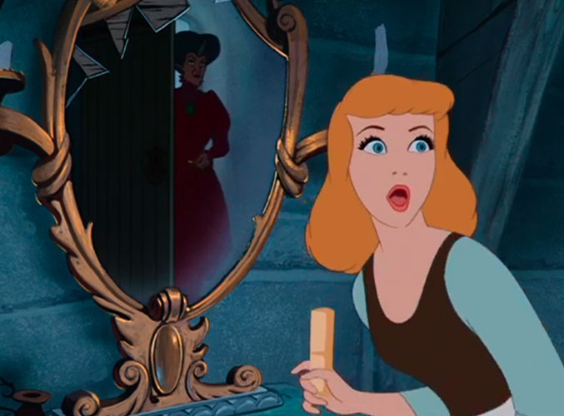
Motif of Mirrors
Why does the film have this repetition of images? What do they represent?

Slide 8
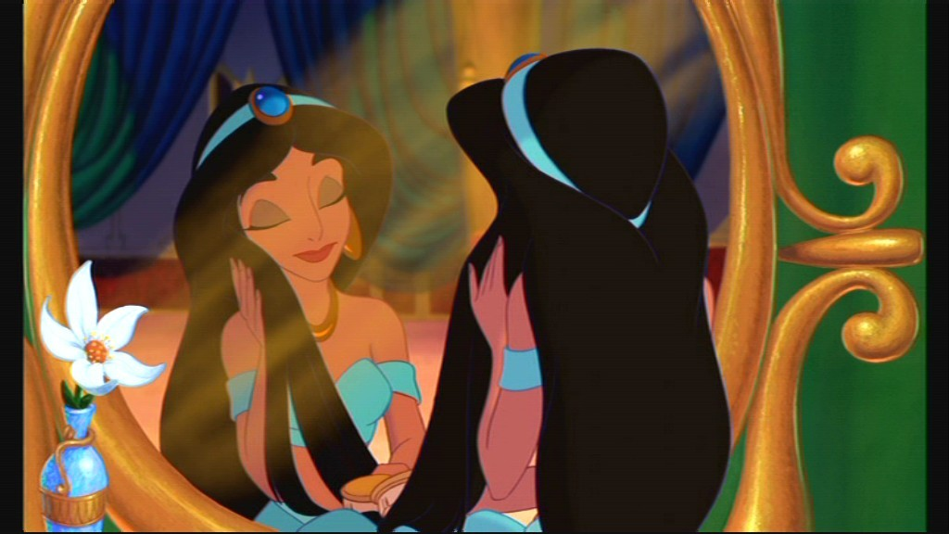
Mirrors are popular motifs across Disney films
Jasmine in Aladdin

Slide 9
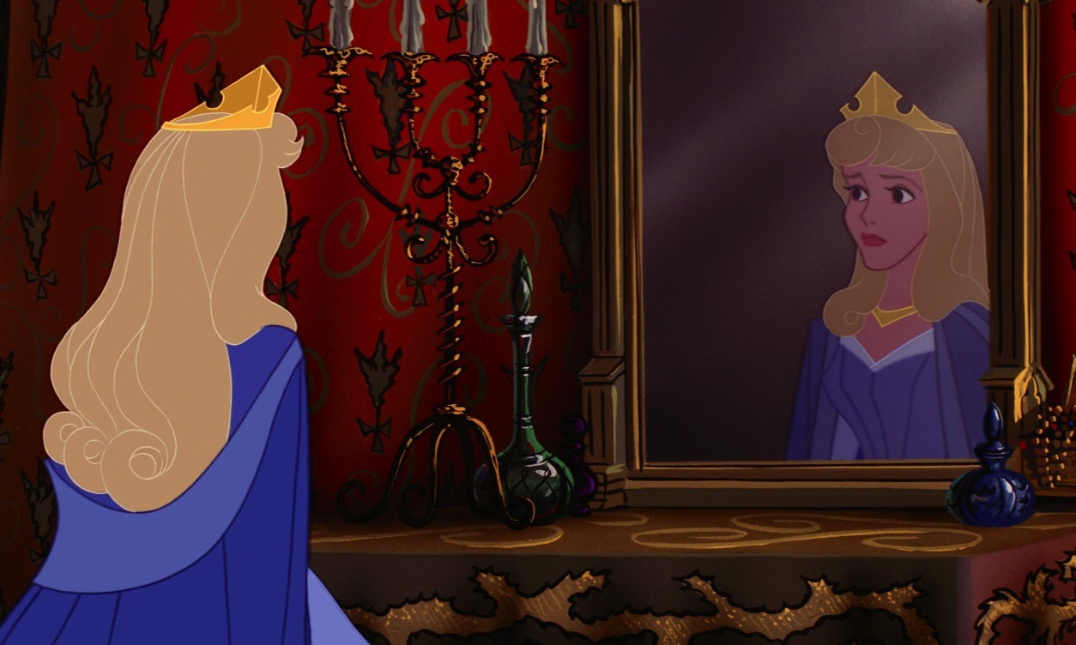
Aurora
Sleeping Beauty

Slide 10
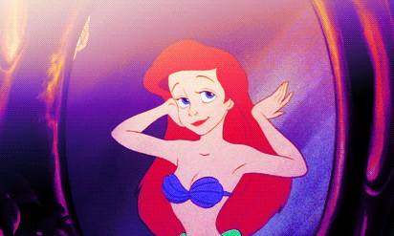
Ariel
The Little Mermaid

Slide 11
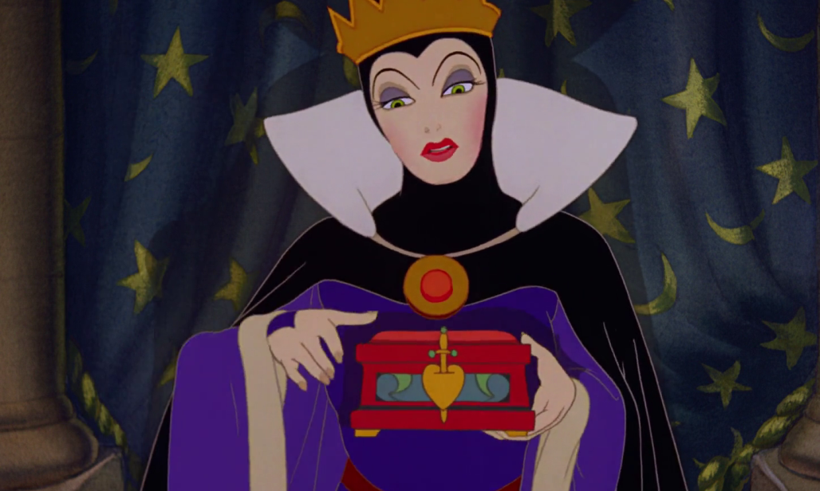
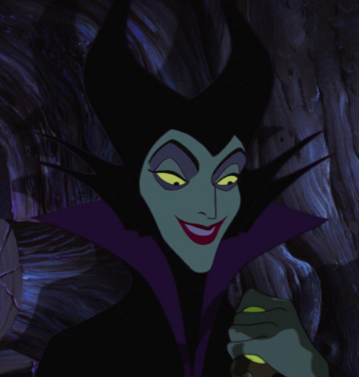
Badly Behaved Women in Disney film

Slide 12
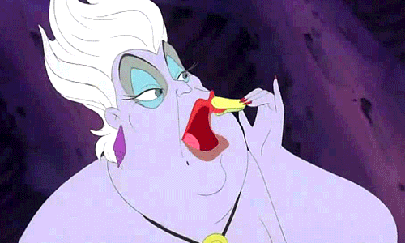
Hyper-Femininity
Vanity re-directed and made more obvious and comical

Slide 13
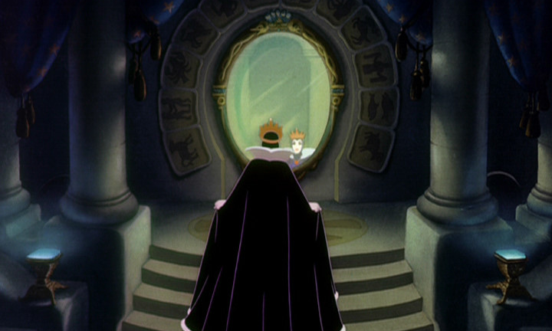
Different kind of vanity
Vanity becomes form of evil

Slide 14
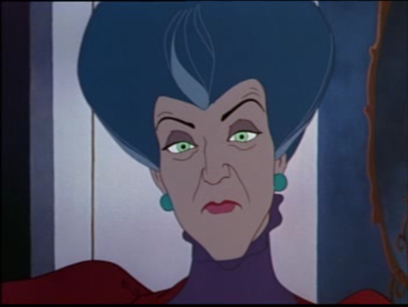
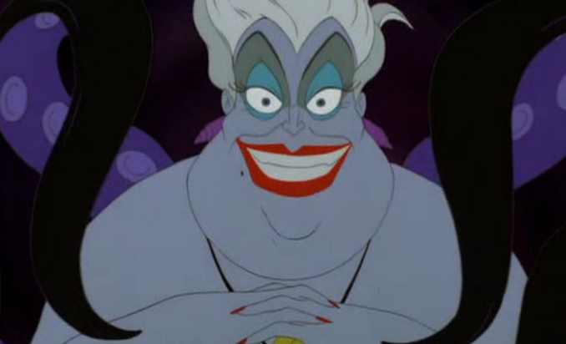
Evil looks evil
Lady Tremaine having her epiphany moment
Ursula the sea witch hatching her diabolical scheme

Slide 15
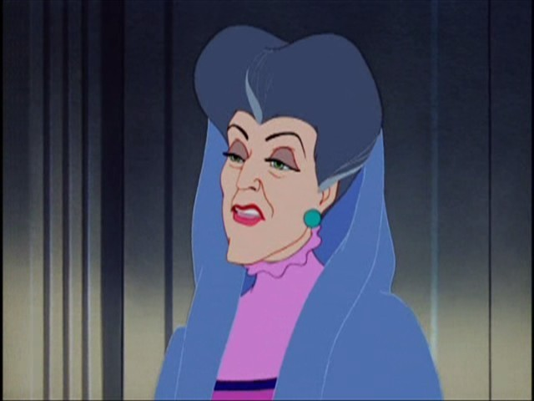
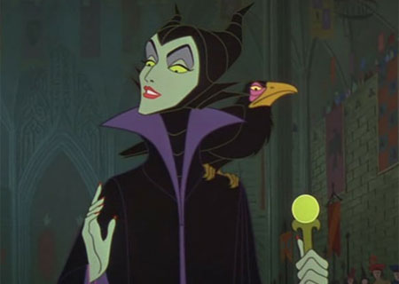
Evil women and angular faces
Lady Tremaine
Maleficent

Slide 16
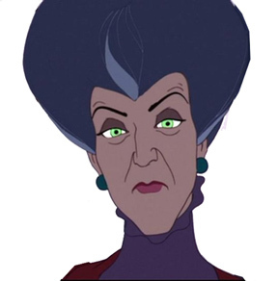
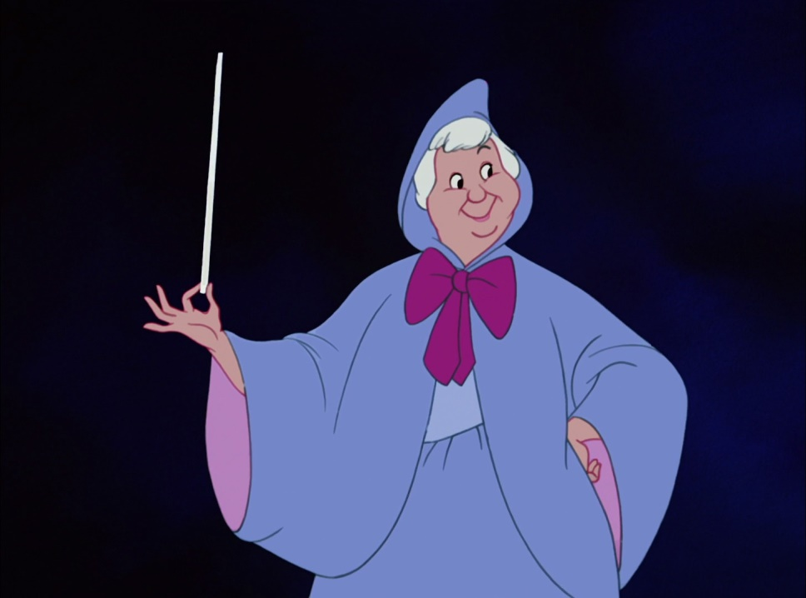
Surrogate mother Figures
Anti-Maternal
Maternal

Slide 17
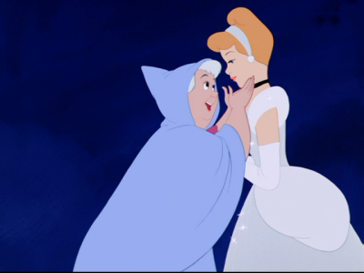
Godmother
What gifts does she bestow upon Cinderella and to what effect?

Slide 18
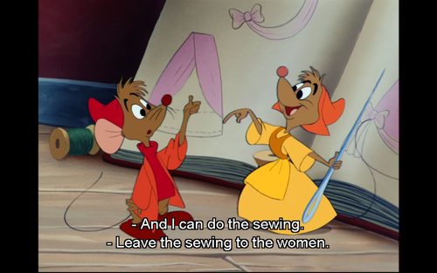
Even Cartoon animals enjoy gender conformity
You got get the trimming!
Hunter/Gatherer

Slide 19
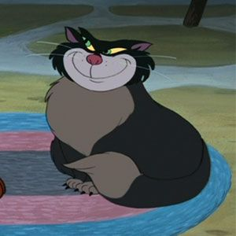
Lucifer

Slide 20
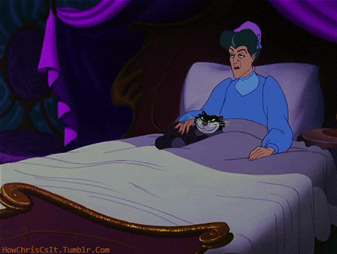
Cat and Step-mother bond

Slide 21
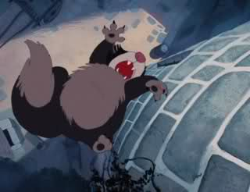
Death scene and punishment

Slide 22
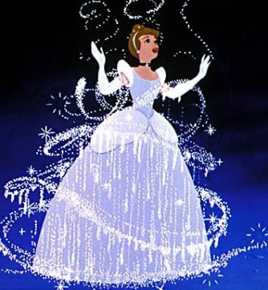
Silver and Glass Motif

Slide 23
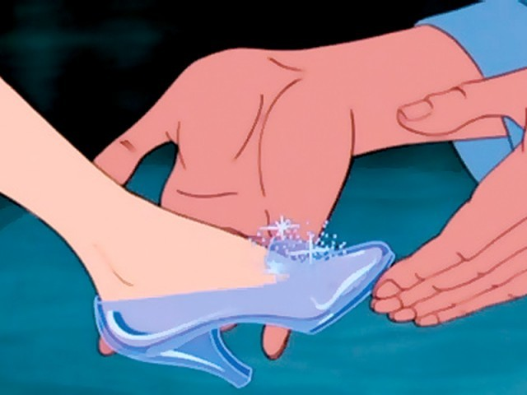
Note the size of her foot

Slide 24
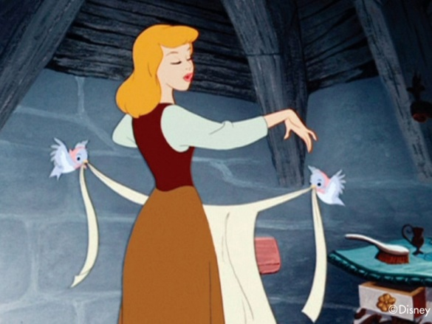
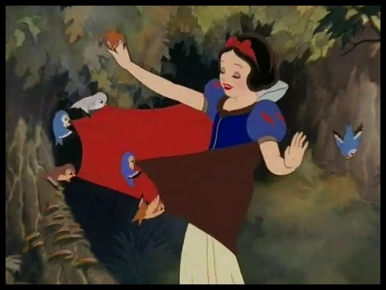
Animal Helpers
Cinderella (and birds)
Snow White (and birds)

Slide 25
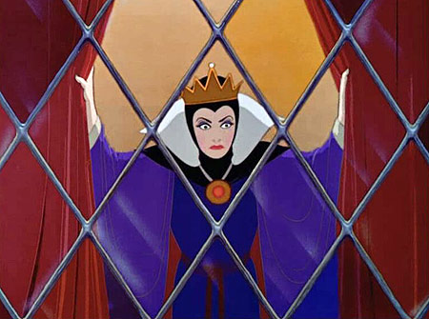
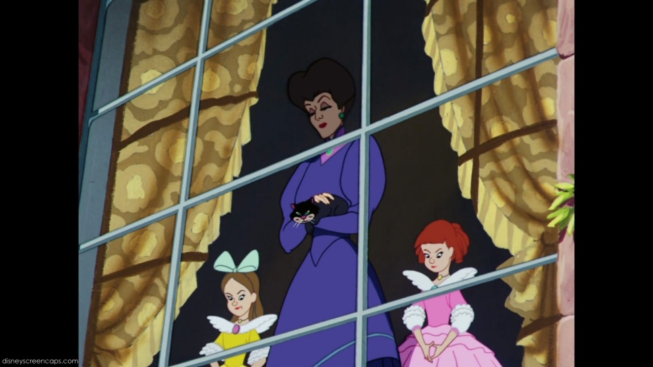
Watching from Above
Evil Queen
Evil Stepmother and Step-sisters

Slide 26
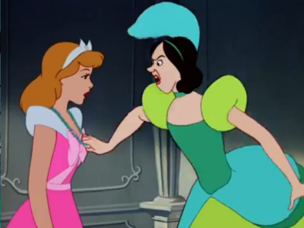
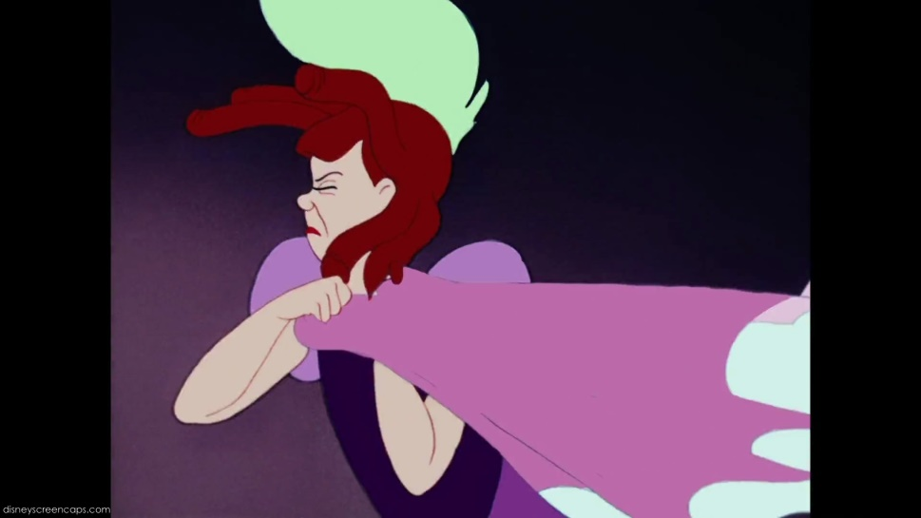
Catty, materialistic, and violent female behavior
Sash
Beads

Slide 27
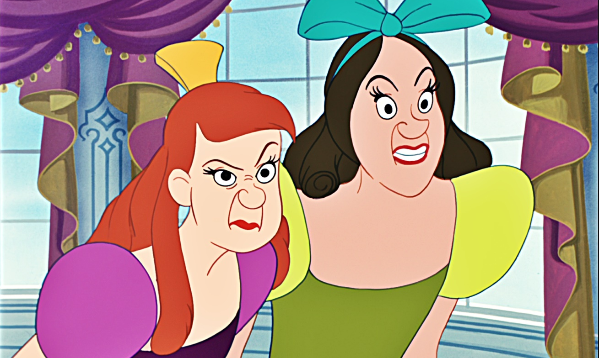
Evil is ugly
Physiognomy as yet another Disney trope

Slide 28
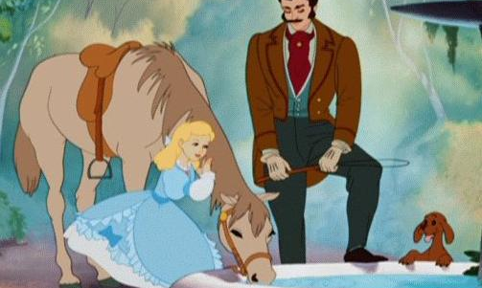
Father figure
COMPARE TO FAIRY TALES

Slide 29
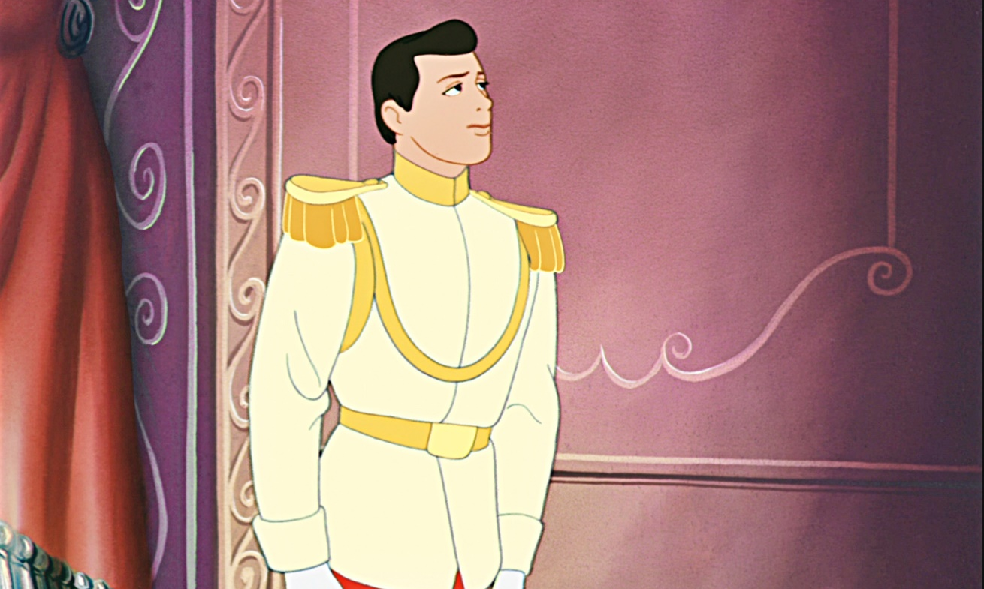
What about this guy?
What makes him so charming anyway?

Slide 30
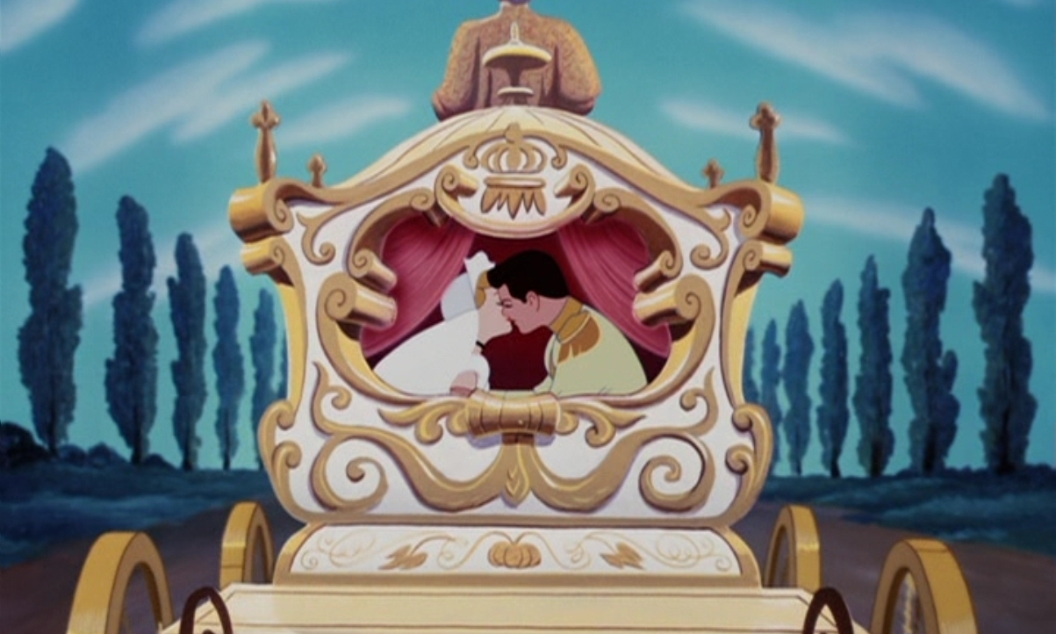
Happily ever after
Note the perfect symmetry of this shot

Slide 31
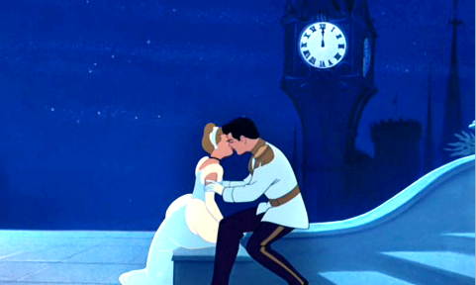
Disney and Kissing

Slide 32
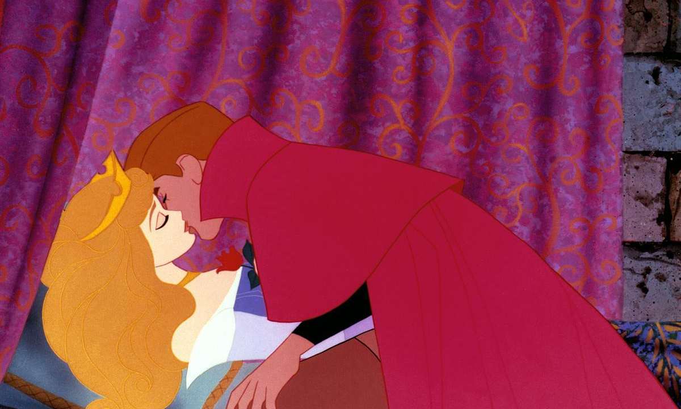
Unconscious woman

Slide 33
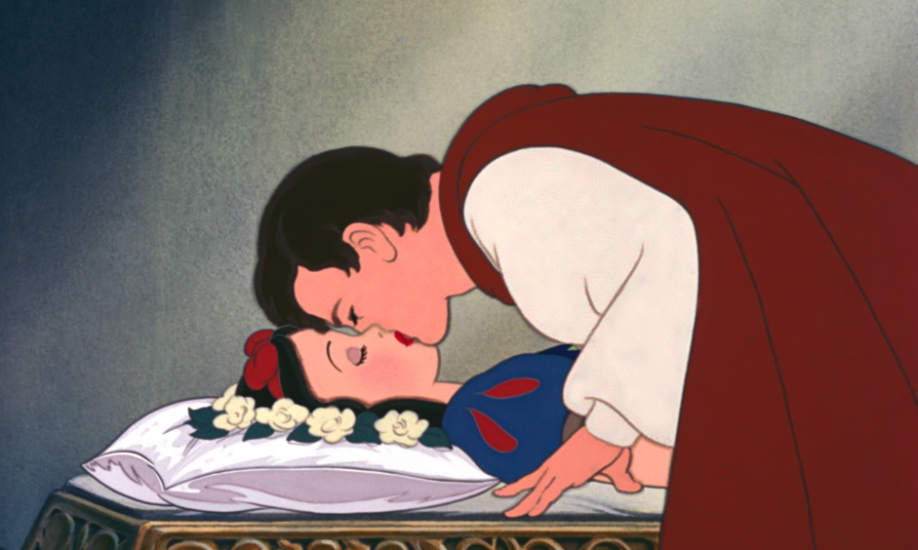
Technically dead woman

